Slide 1

GURU NANAK INSTITUTE OF TECHNOLOGY
DEPARTMENT OF ECE
ANALYSIS OF THE WATER QUALITY MONITORING SYSTEM
Ch K Chaitanya 17831A0414
ECE-4A.
K Raja 17831A0435
ECE-4A.
K Sai Teja
17831A0436
ECE-4A.
Under the guidance of
Mr S Sivaiah
Assistant Professor
ECE Department,GNIT

Slide 2
INTRODUCTION
Monitoring provides the objective evidence necessary to make decisions on managing water quality today and in the future.
Analysis based on monitoring data helps lawmakers and water managers measure the effectiveness of water policies, determine if water quality is getting better or worse, and formulating new policies to better protect human health and the environment.
Providing accurate and timely information on the quality of water by finding Comparative data between PH & Turbidity in relation to water quality standards.

Slide 3
USEFULNESS TO THE SOCIETY
As 21st century is a growing challenge because of the large number of chemicals used in our everyday lives and in commerce that can make their way into our waters.
Water quality monitoring is an important aspect to provide safe drinking water to the environment and keep the naturally gifted resource safe from getting contaminated.
So, this project helps in providing total data regarding the purity of water is displayed on the webpage and is analyzed in the form of a graph, pie chart and values are given in the table.

Slide 4
EXISTING SYSTEM
The current Water Quality observing framework include human towards looking at the water Quality, Testing.
At present many measures are taken and innovative development has been introduced in water quality checking.
These are finished by utilizing an automated laser bar and advanced camera.

Slide 5
Author | Description of Paper Work
Monira Mukta & Samia Islam | They designed a system for IoT (Internet of things) based smart water quality monitoring (SWQM) system that aids in continuous measurement of water condition based on four physical parameters.
A.N.Prasad, K. A. Mamun, F. R. Islam, H. Haqva | They presents a smart water quality monitoring system for Fiji, using IoT and remote sensing technology.
Kamarul Hafiz Kamaludin & Widad Ismail | Their paper suggests an IoT based system implementation by embedding the RFID , WSN platform and IP based communication into a single platform for WQM purpose.
Yi Hong Wang, Ju Chen, Shi Feng Tao | The system adopts a modular design concept as a whole, which is mainly composed of a main controller, a sensor and a wireless communication module.
Aravindan S.Rao, Stephan Martial, Jayavardhan Gubbi. | They developed a low-cost autonomous water quality monitoring system.

Slide 6
Author | Description of Paper Work
Vaishnavi V, Varshitha R C, Tejaswini M | They suggested system is a minimal price real time water quality monitoring system in IoT environment.
Daigavane and Dr. M.A Gaikwad | They highlights water quality monitoring methods, sensors, embedded design, and information dissipation procedure, role of government, network operator and villagers in ensuring proper information dissipation.
L. Lakshmanan, Jesudoss A, Sivasangari A, Sardar Maran and Mercy Theresa M | They proved PH and turbidity parameters thus calculated are stored in a tabular format and is shown on pc.
Dong He & Li-Xin Zhang | They entire system consists of two parts: the WSN and Remote Data Center.
Supriya R. Khair & Revati M. Wahul | They proved analyzing and evaluating the nature and extent of corrective action to be taken and how much pollution control is necessary, and effectiveness of quality and pollution control measures which need to be taken by the observer.

Slide 7
PROPOSED SYSTEM
In the proposed system, the water quality will be checked by the Ph and turbidity sensors which are connected to the Node MCU microcontroller. The data is collected and is sent to the cloud for storage. The values are stored in a tabular format. We can get alert message notifications to the registered mobile number through SMS if the sensor reaches above the limit i.e. Ph<7 and turbidity>60 using GSM. The values that are stored in a tabular form are analyzed in the form of line graphs and pie charts.

Slide 8
PROS OUTWEIGH THE CONS
Existing System
Proposed System
Water Quality is Monitored by a laser bar and advanced camera.
PH Sensor & Turbidity Sensor is used for monitoring Data.
It is time taking process.
It helps in Analysis the sensor data immediately and wirelessly to the robust servers.
Implementation of the system turns costly.
The system is very cheap as the hardware and software do not cost much.
The analysis includes different stages.
It very easy to plot the data collected in various formats for proper analysis.
Maintaining involves Human Effort.
It is very easy to maintain the WIFI based water quality monitoring system

Slide 9
ABSTRACT
Nowadays many people are suffering from dangerous diseases which are caused due to impure water. In our project, we are doing an analysis for a water quality monitoring system, which gives data about the quality of water, on a webpage. The quality of water is determined using various sensors like PH sensor and turbidity sensor, connected to the Arduino family microcontroller. The Arduino software is written in embedded C and GSM module is connected to the Arduino. The data will be transferred constantly from the remote sensor organize through a microcontroller and Wi-Fi. Wi-Fi module is used to send data to the webpage via the internet which is connected to the microcontroller.

Slide 10
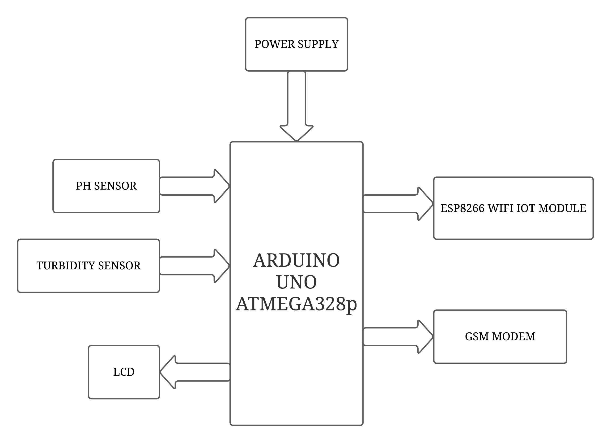
BLOCK DIAGRAM

Slide 11
BLOCK DIAGRAM DESCRIPTION
POWER SUPPLY: It is used to provide 5V DC Power to the kit. It is necessary for the functioning of the kit.
ARDUINO UNO: It is used to provide required outputs from input signals. It has a predefined code that compares input signals with values in it and stimulates output response accordingly.
GSM: It is used to send messages to the registered mobile number based on the conditions in the code. It is an output signal from Arduino.
LIQUID CRYSTAL DISPLAY: It is used to display multiple characters. Based on the predefined code and input signal, it gets an input from Arduino to display the information.

Slide 12
BLOCK DIAGRAM DESCRIPTION
PH SENSOR: It is one of the most essential tools that's typically used for water measurements. This type of sensor is able to measure the amount of alkalinity and acidity in water and other solutions.
TURBIDITY SENSOR: The turbidity probe works by sending a light beam into the water to be tested. This light will then be scattered by any suspended particles.
WIFI IOT MODULE: ESP8266 is a low-cost Wi-Fi microchip, with a full TCP/IP stack and microcontroller capability & a Serial/UART to WiFi module is a great way to connect Arduino Uno to a WiFi network.

Slide 13
HARDWARE COMPONENTS
POWER SUPPLY
ARDUINO
PH SENSOR
TURBIDITY SENSOR
WIFI IOT MODULE
GSM
LCD

Slide 14
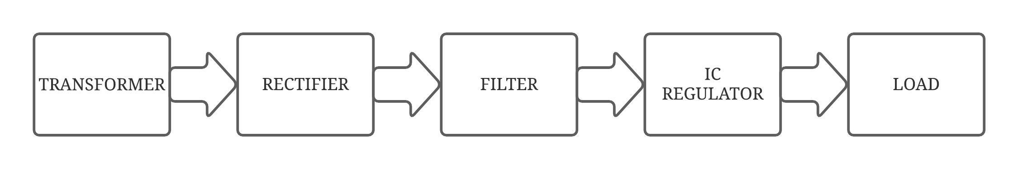
POWER SUPPLY:

Slide 15
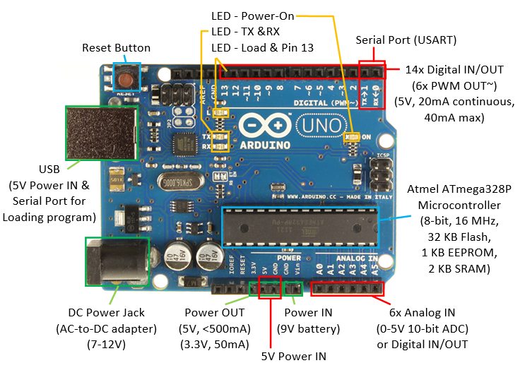
ARDUINO:

Slide 16
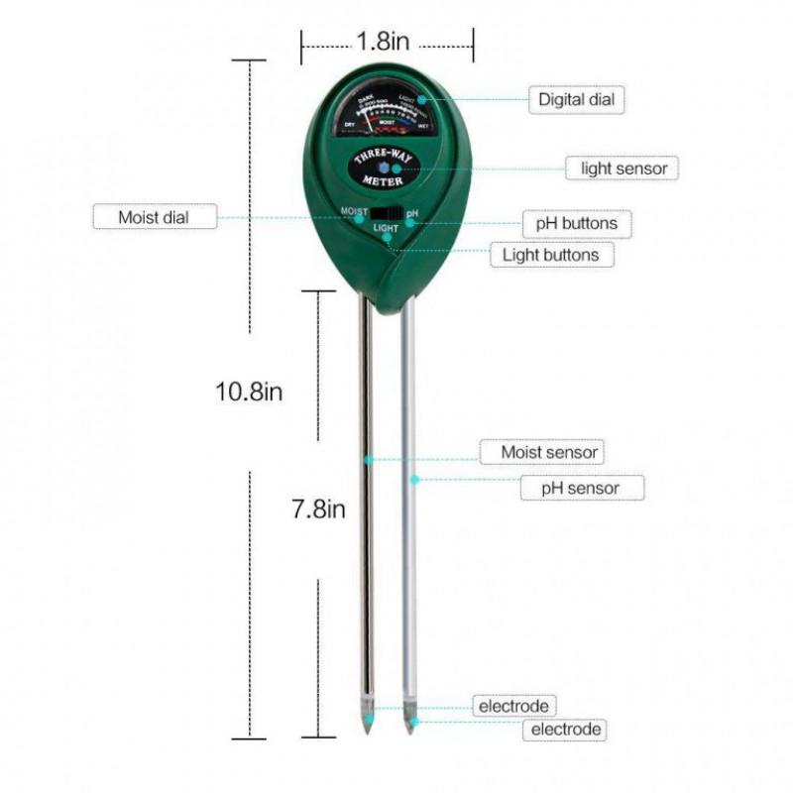
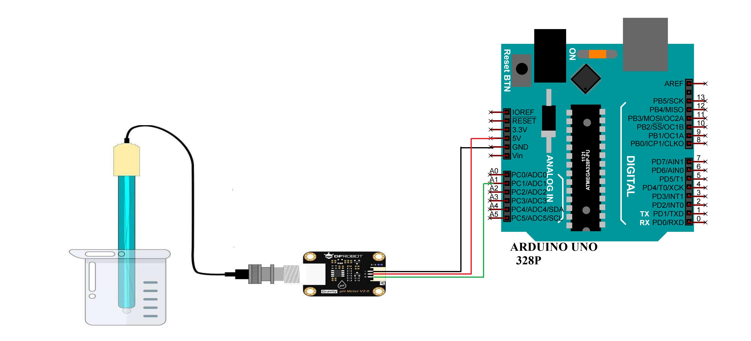
PH SENSOR:
Interfacing of PH Sensor with Arduino

Slide 17
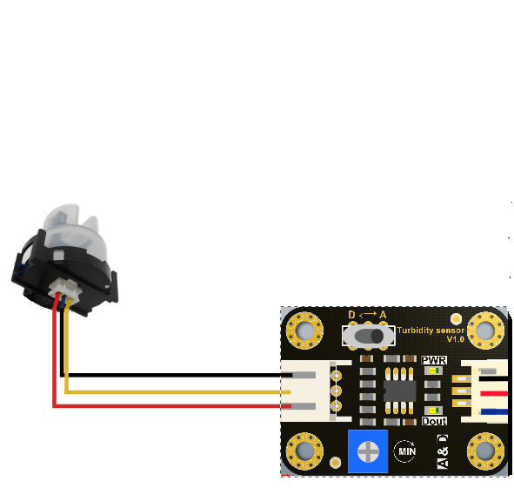
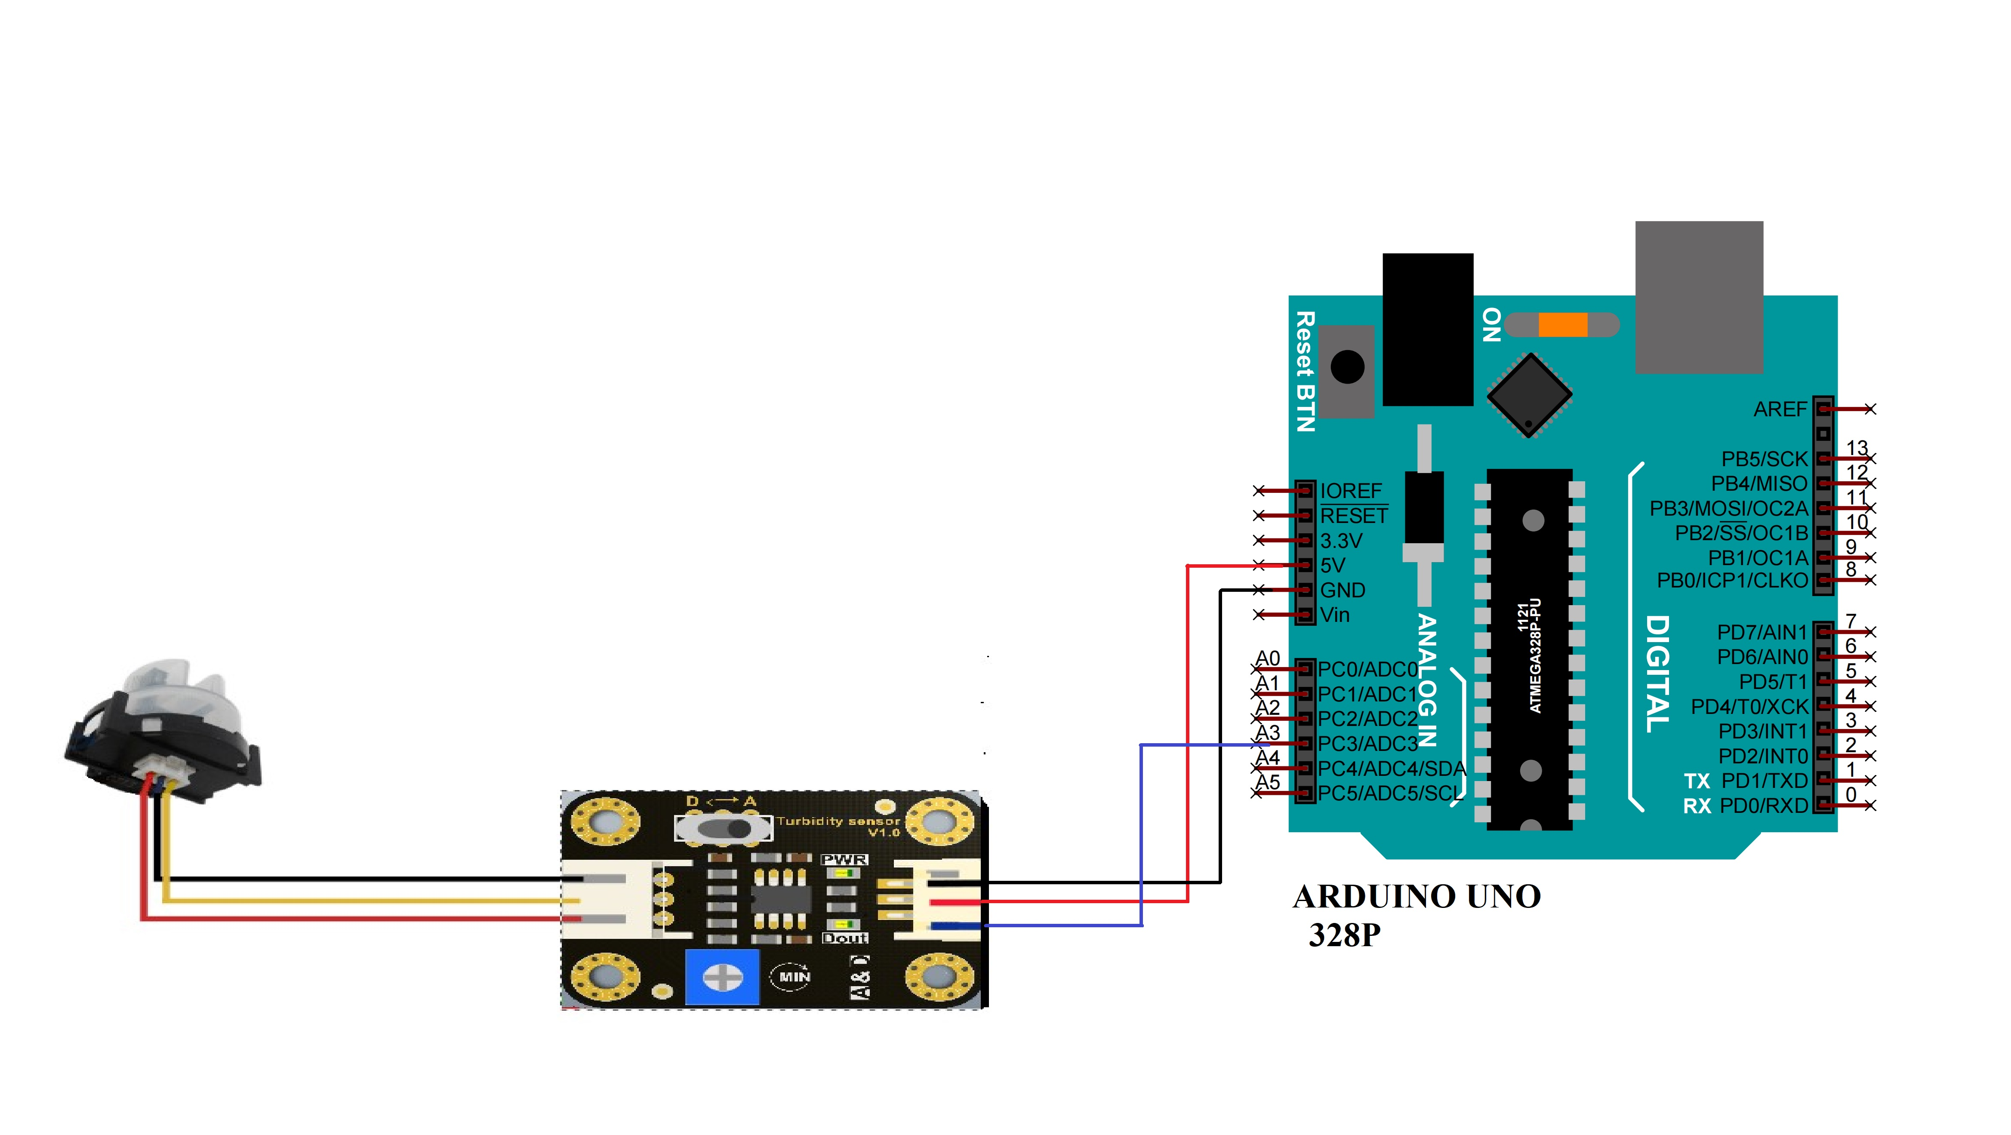
TURBIDITY SENSOR:
Interfacing of Turbidity Sensor with Arduino

Slide 18
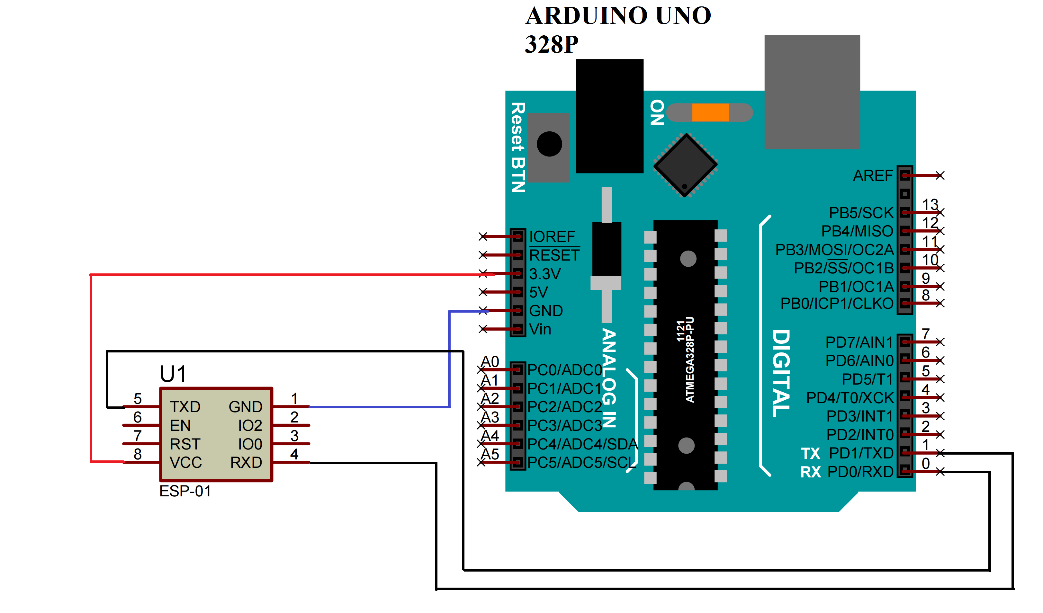
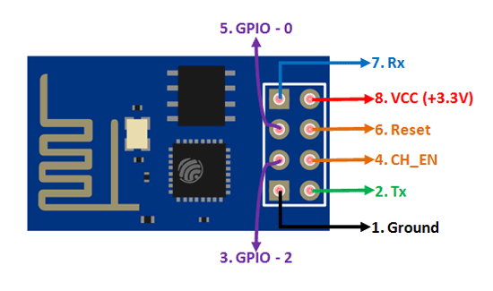
WIFI IOT MODULE:
Interfacing of Wifi Iot Module with Arduino

Slide 19
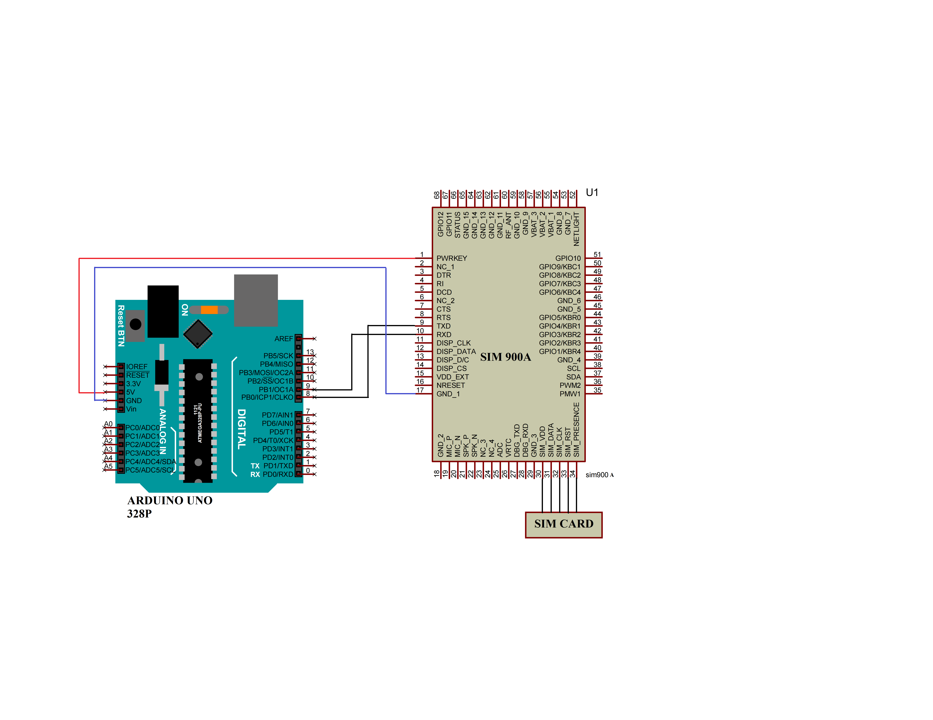
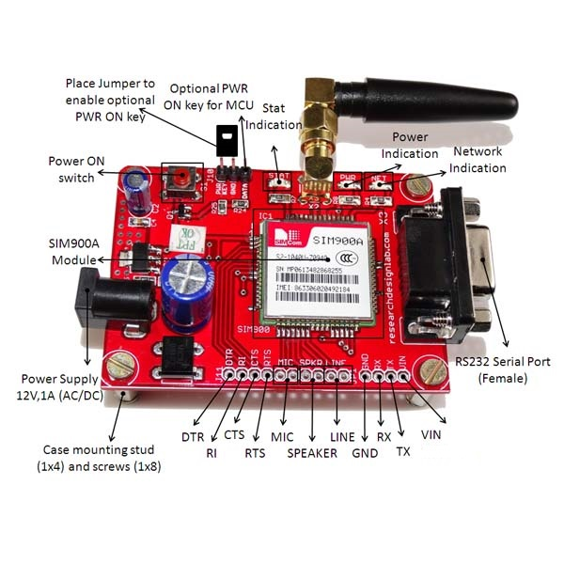
GSM:
Interfacing of GSM with Arduino

Slide 20
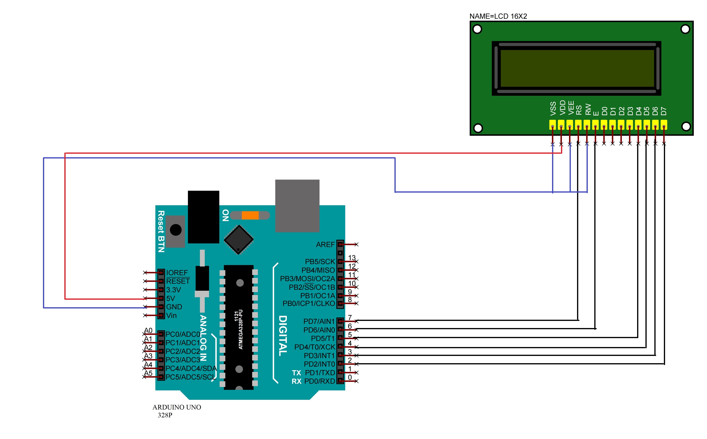
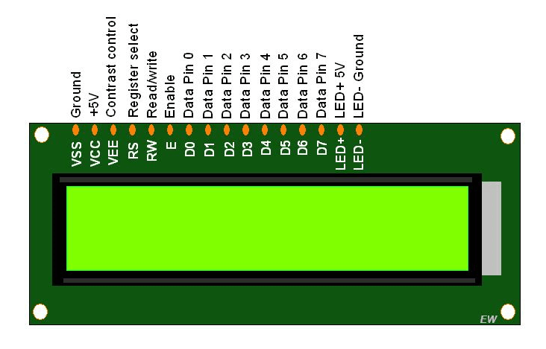
LCD:
Interfacing of LCD with Arduino

Slide 21
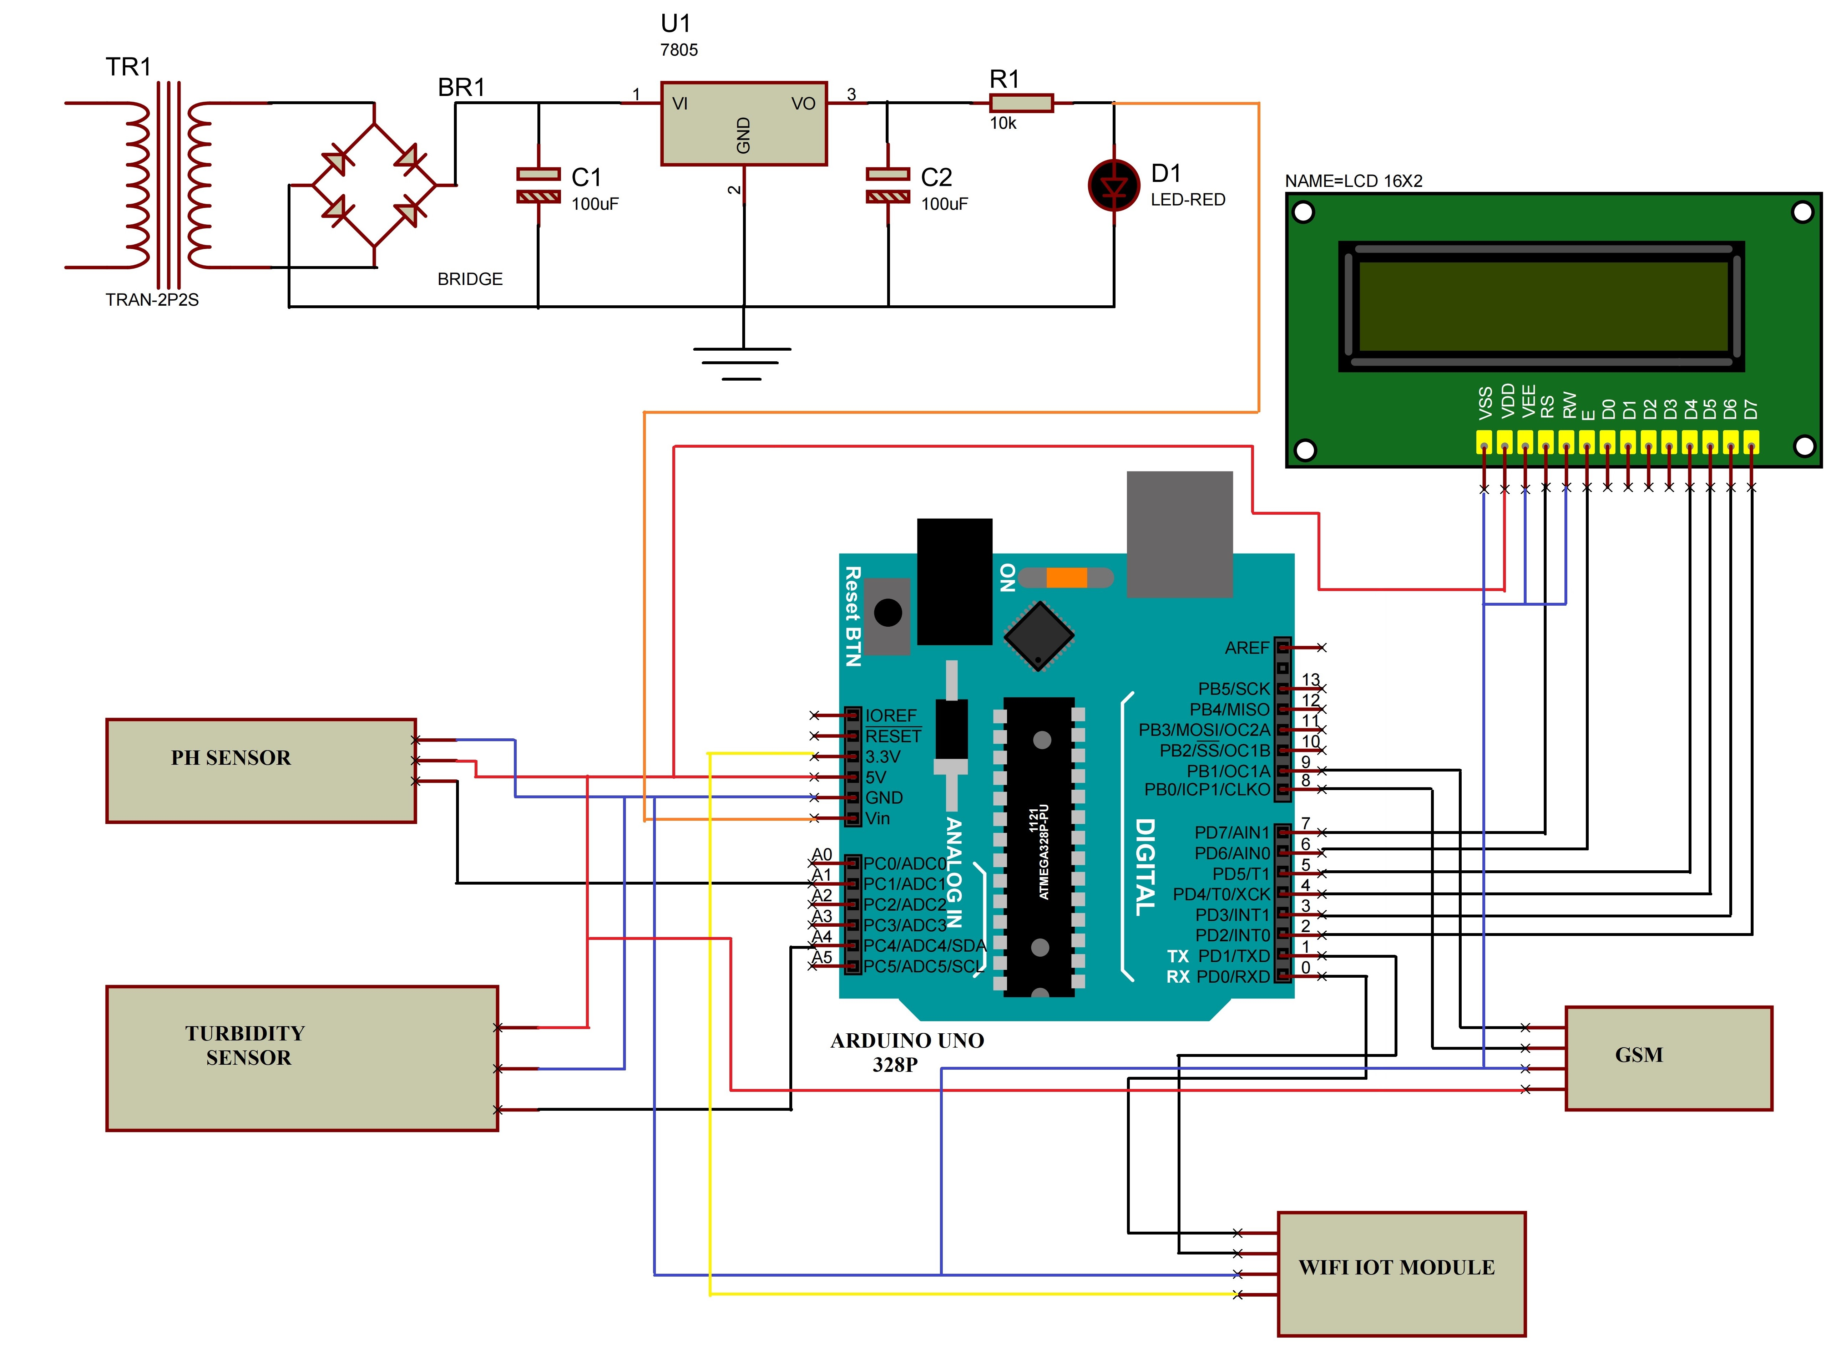
CIRCUIT DIAGRAM:

Slide 22
EXPLANATION:
Vin pin of Arduino is connected to positive Power Supply.
5V output pin of Arduino is connected to VDD pin of LCD
LCD’s Bi-directional data bus D7-D4 pins are connected with digital pins (2-5) of Arduino Uno.
 Register select, Enable pins are connected to digital pins (7,6) of Arduino Uno respectively.
Vss, RW and VEE pins of LCD are connected to ground.
3.3V and ground pins of Arduino is connected to VCC and ground pins of WIFI IOT Module.

Slide 23
Rx and Tx pins of WIFI IOT Module are connected to Tx and Rx pins of Arduino respectively.
Dout of Turbidity Sensor is connected to Analog pin (4) of Arduino uno.
5V and ground pins of Arduino is connected to VCC and ground pins of Turbidity Sensor respectively.
Output pin of PH Sensor is connected to Analog pin(1) of Arduino uno.
5V and GND pins of Arduino is connected to VCC and GND pins of PH Sensor.
Tx & Rx of GSM are connected to digital pins (8,9) of Arduino Uno.
5V and GND pins of Arduino is connected to VCC and GND pins of GSM.

Slide 24
SOFTWARE USED:
ARDUNIO IDE: In this software we are writing program for LCD display controlling(i.e content displaying). In this program is written in Embedded C.
GOOGLE APPS SCRIPT: It is a rapid application development platform that makes it fast and easy code in modern JavaScript and have access to built-in libraries for favorite Google Workspace applications.

Slide 25
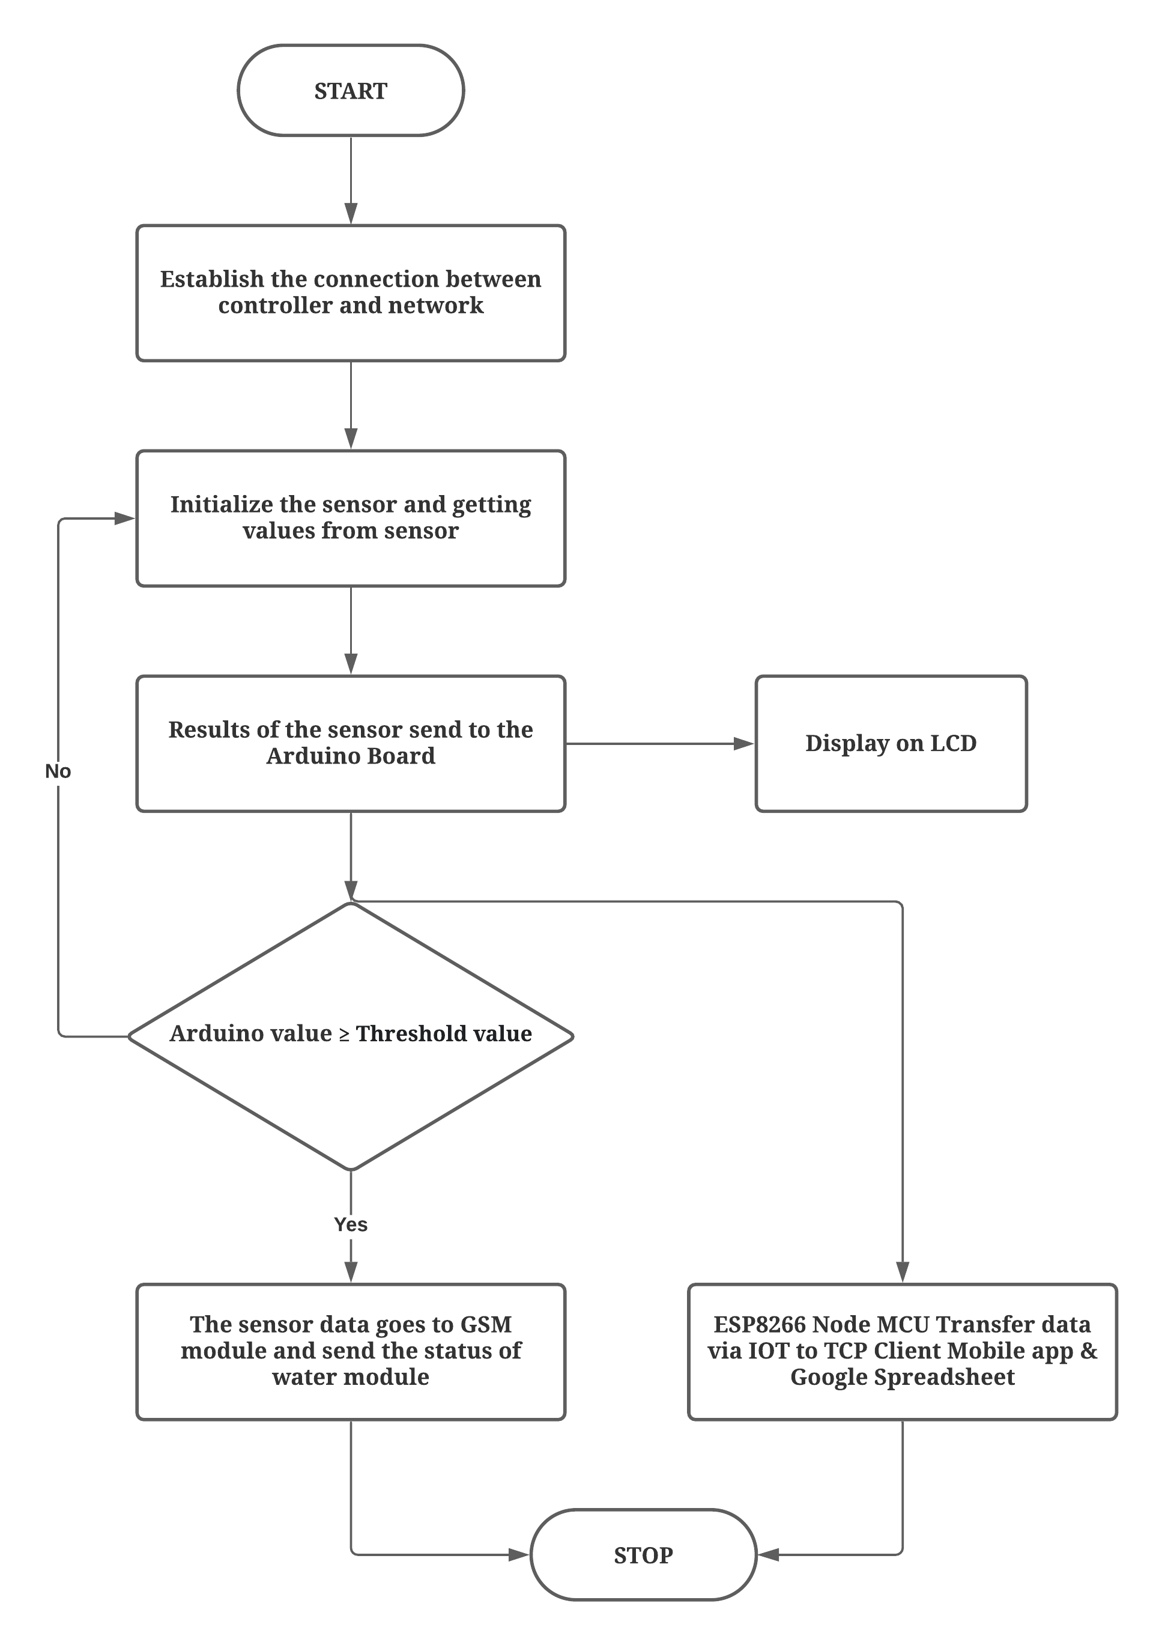
FLOW CHART:

Slide 26
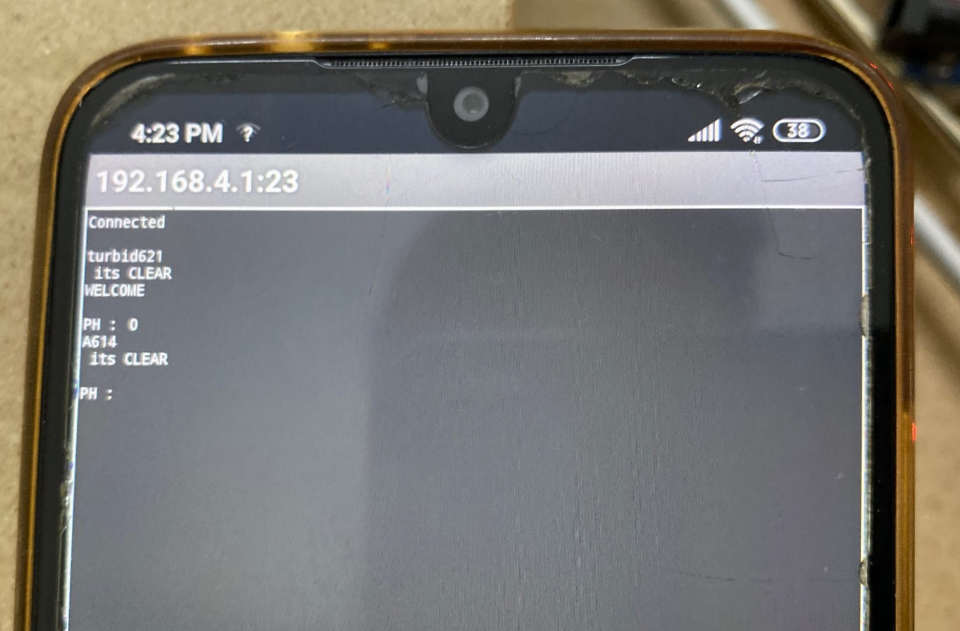
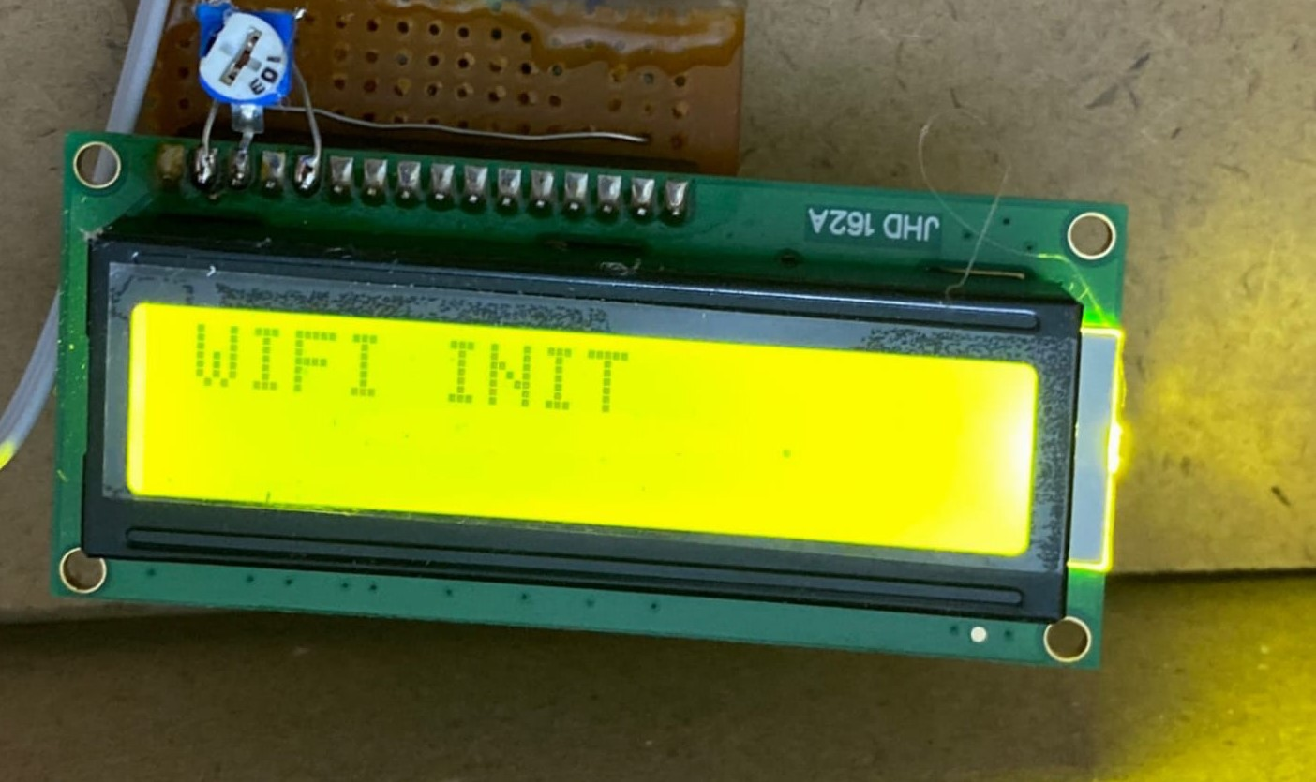
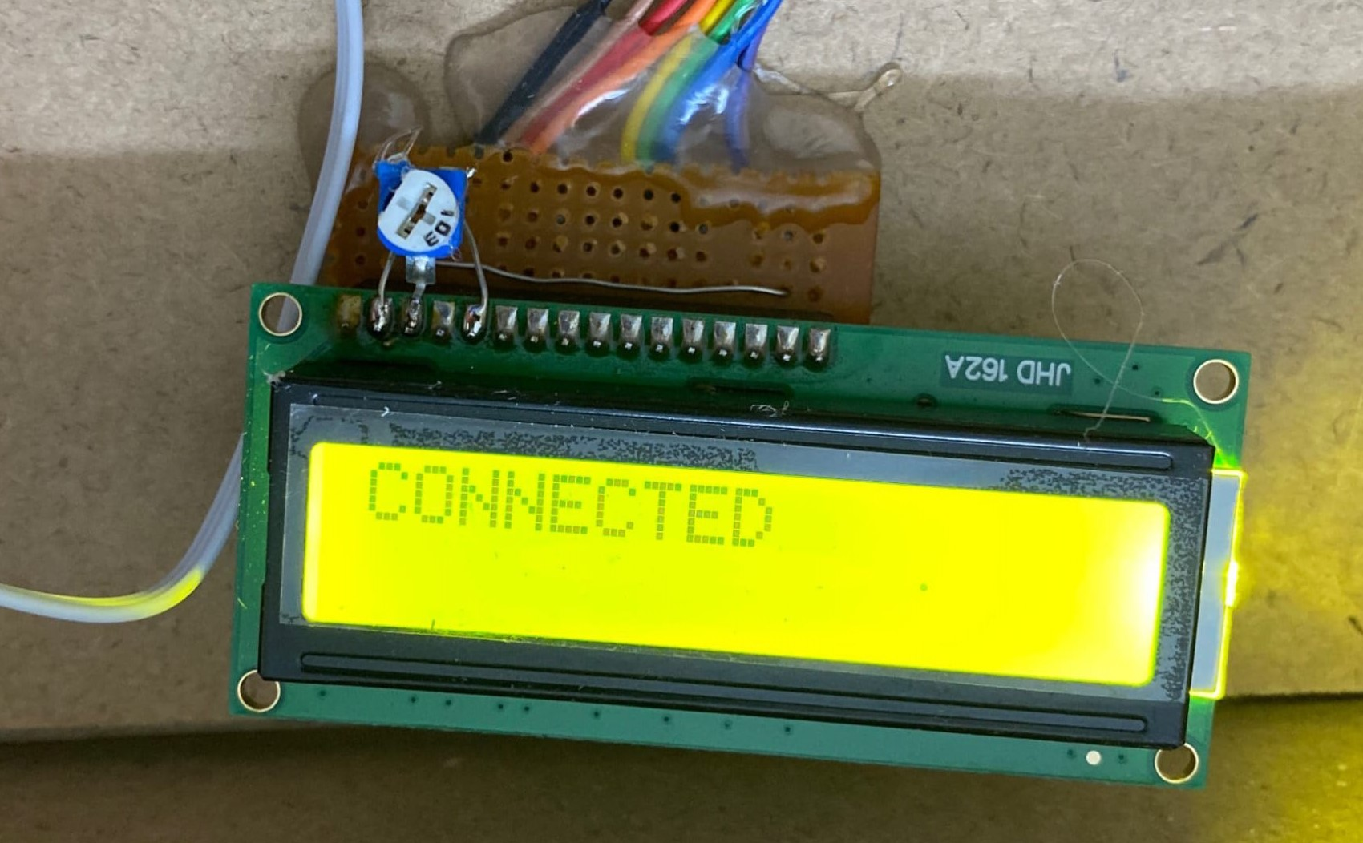
RESULTS
It indicated WIFI is connected to the device.
This figure represents when the WIFI are initialized properly.

Slide 27
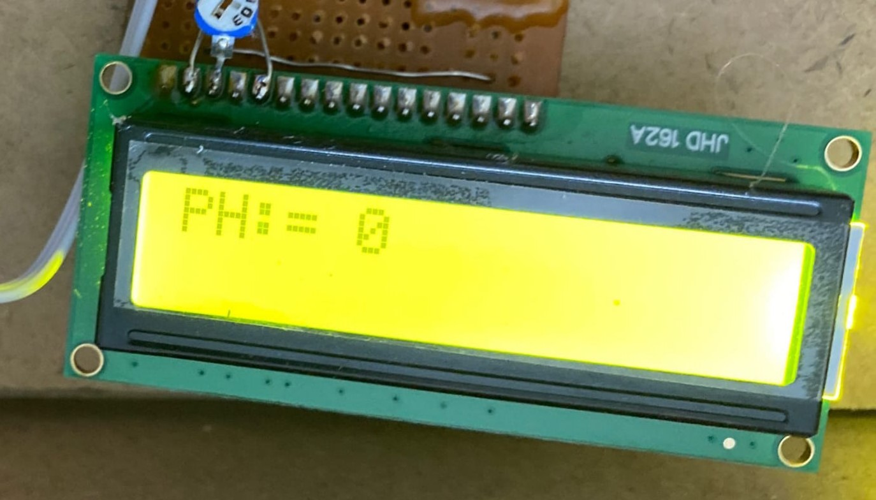
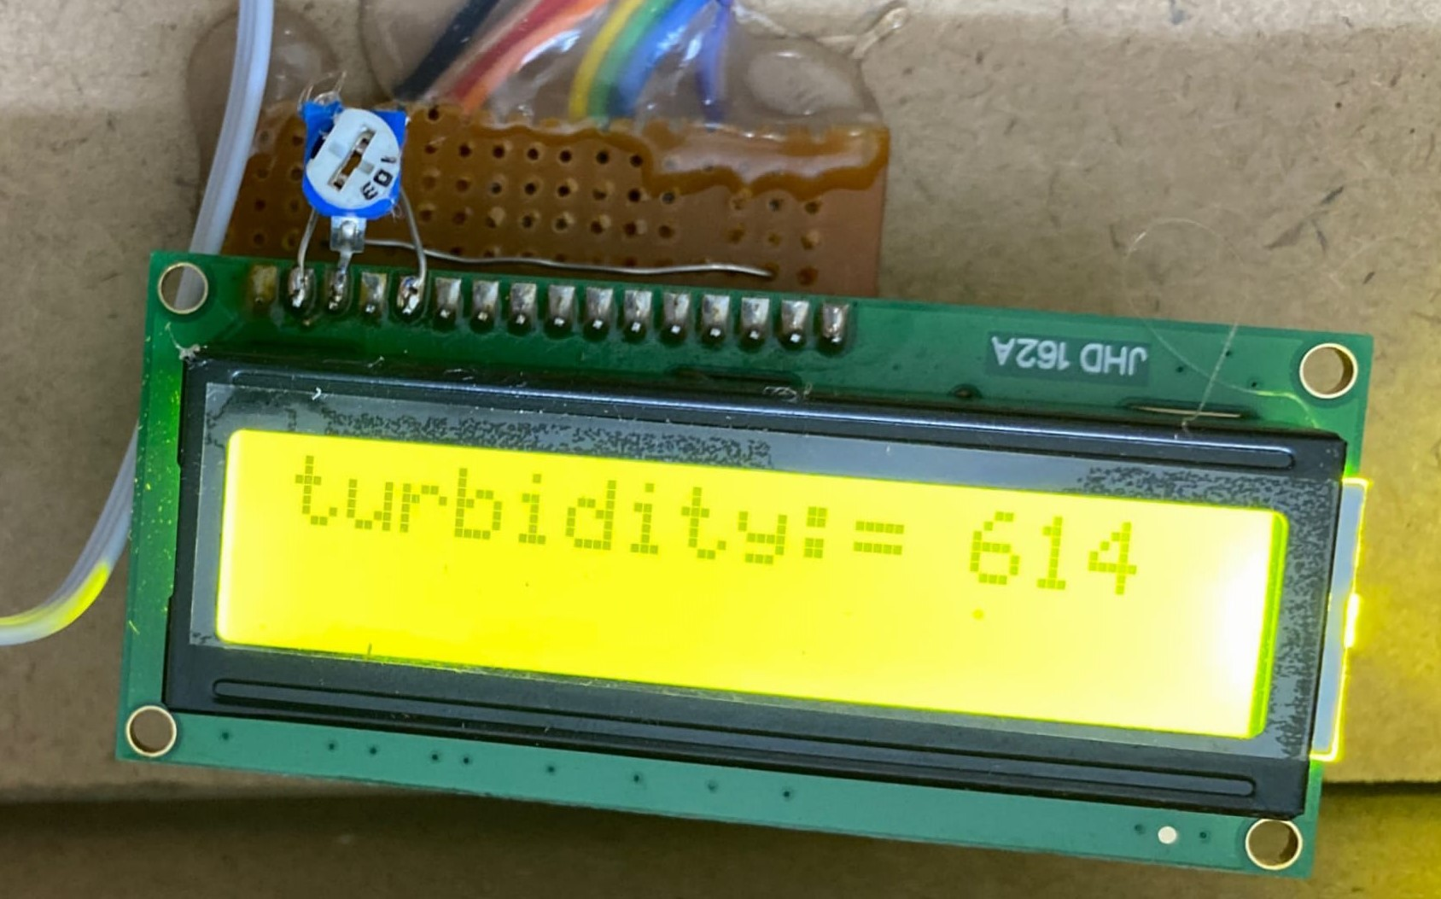
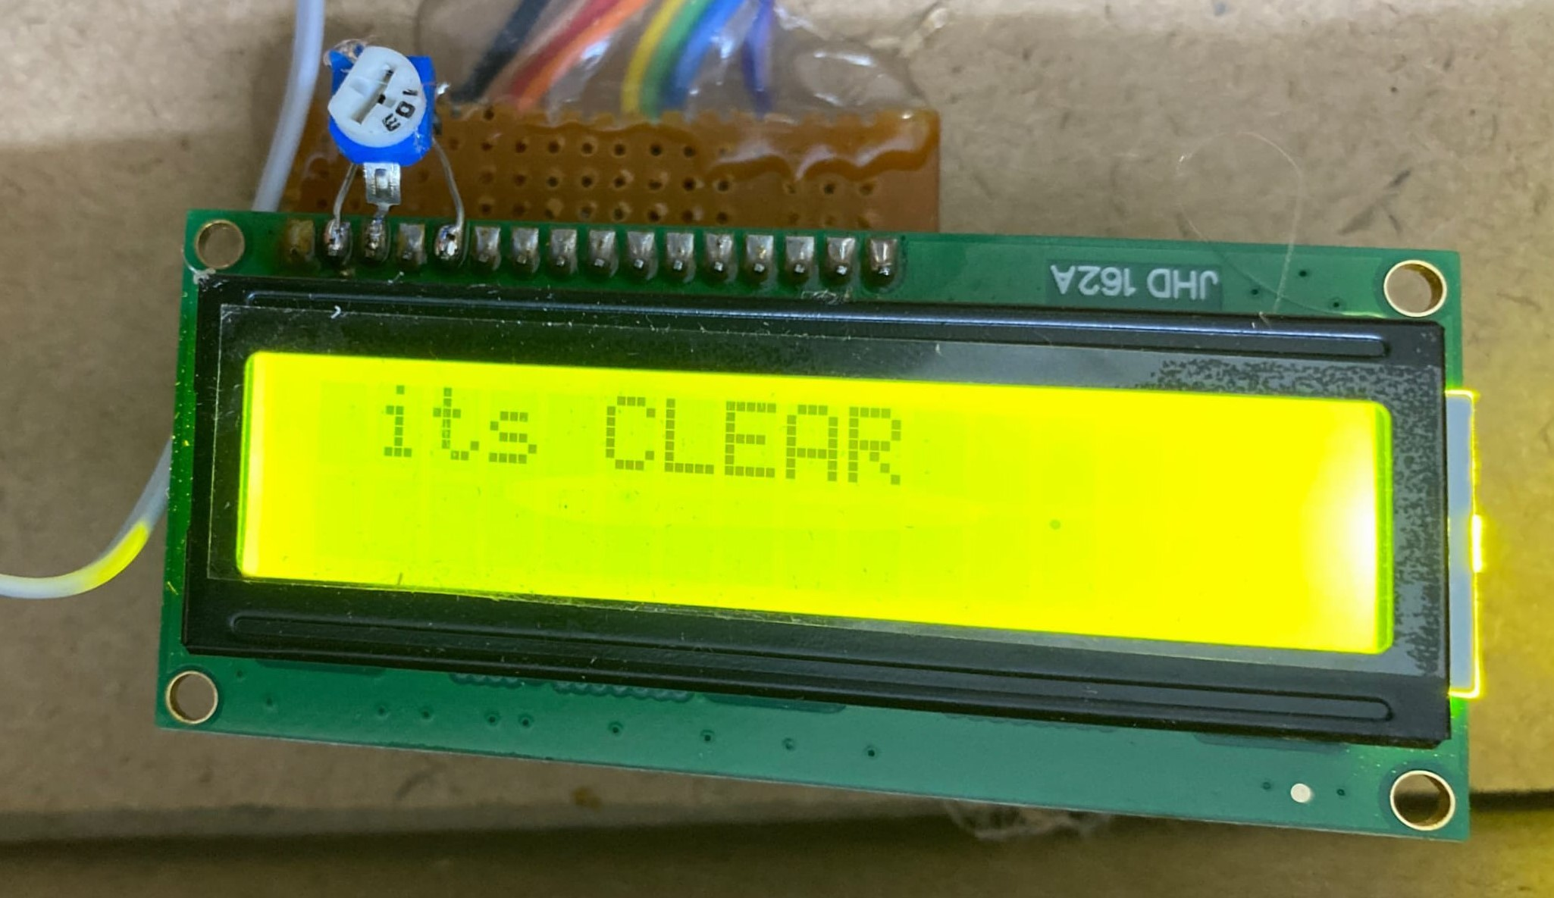
RESULTS
This figure represents PH value.
This figure represents Turbidity value.
This figure indicated water is clear.

Slide 28
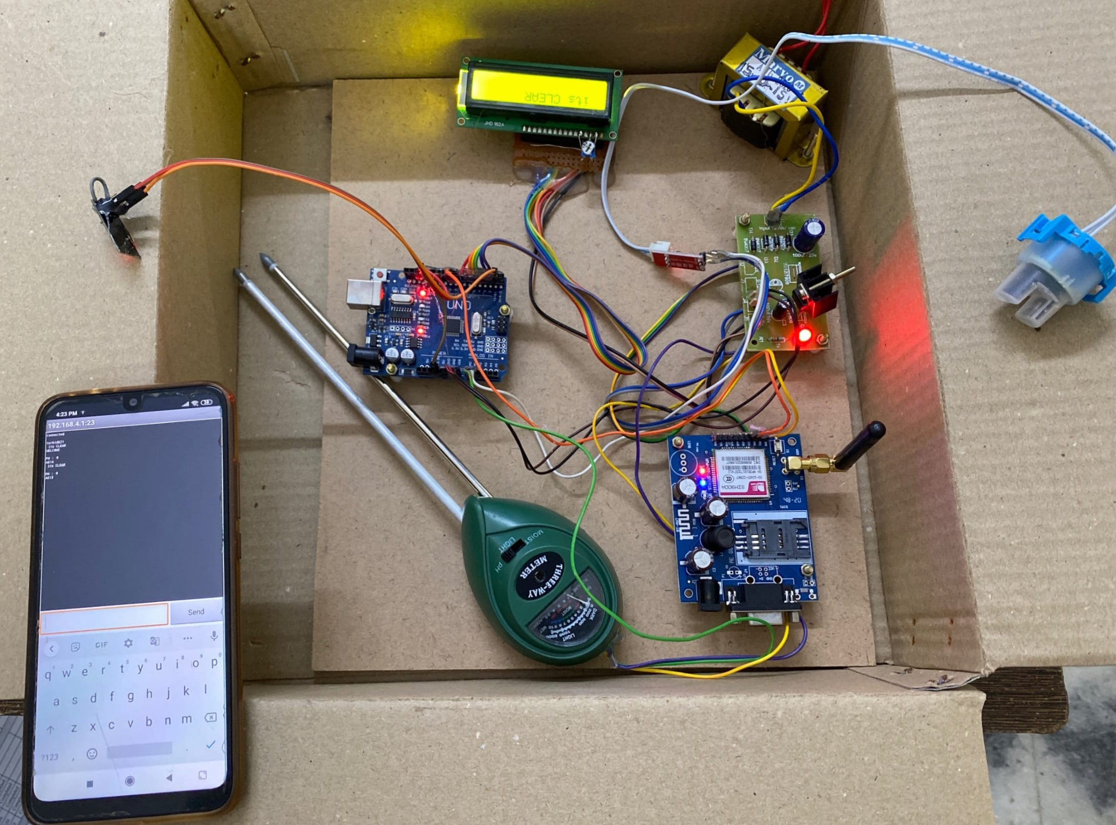
RESULTS
This figure represents entire kit connection.

Slide 29


Slide 30


